Slide 1
Exploring alternative service schemes for busy transit corridors
Weihua Gu, Zahra Amini, Michael Cassidy

Slide 2
Facts
Most transit systems use the traditional all-stop service scheme
There are alternative schemes in use: skip-stop, limited-stop, short-run, express-local, feeder-trunk (hierarchical). However, these service schemes are not common in practice.
Higher agency cost
More transfers
Overtaking between transit vehicles (unsuitable for single-track rail systems)
All-stop service

Slide 3
Questions
How good the alternative schemes can be as compared against the traditional all-stop services? To what extent the existing all-stop systems can be replaced by better alternatives? Shall we build more systems under alternative schemes in the future?
Which alternative scheme to choose?
How to optimally design the alternative schemes?

Slide 4
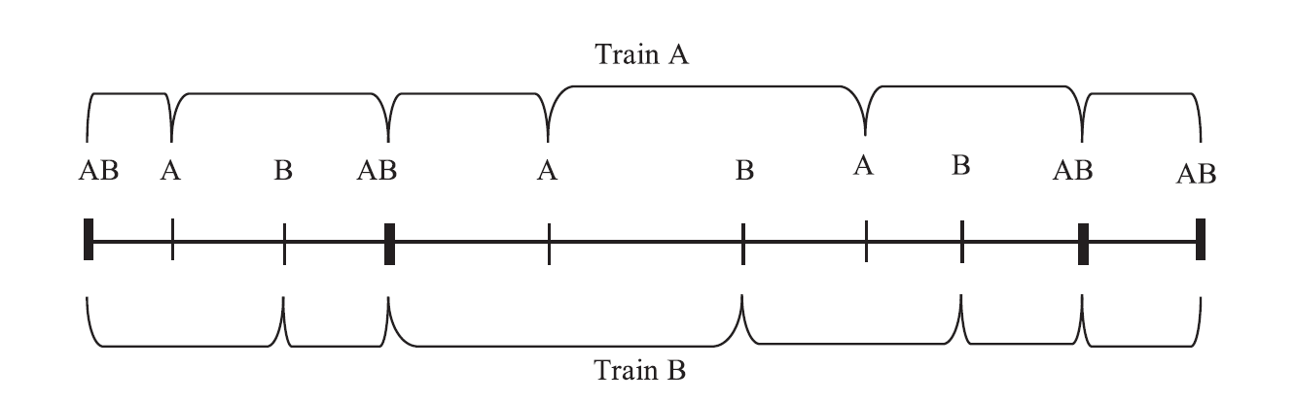

A special skip-stop scheme (Freyss et al., 2013)
No overtaking needed
Can be applied to single-track rail systems
Every trip involves at most one transfer
Two routes only
(Santiago, Chile)

Slide 5
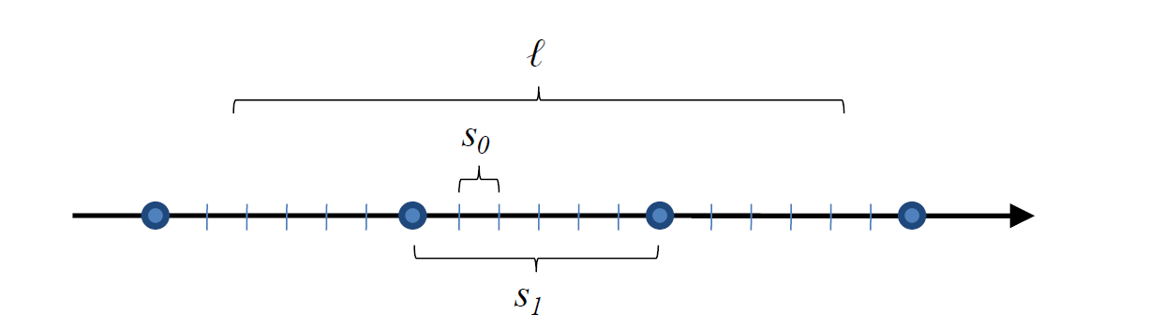
Hierarchical service (Daganzo, 2010)
Every trip involves 2 transfers
No route choice

Slide 6
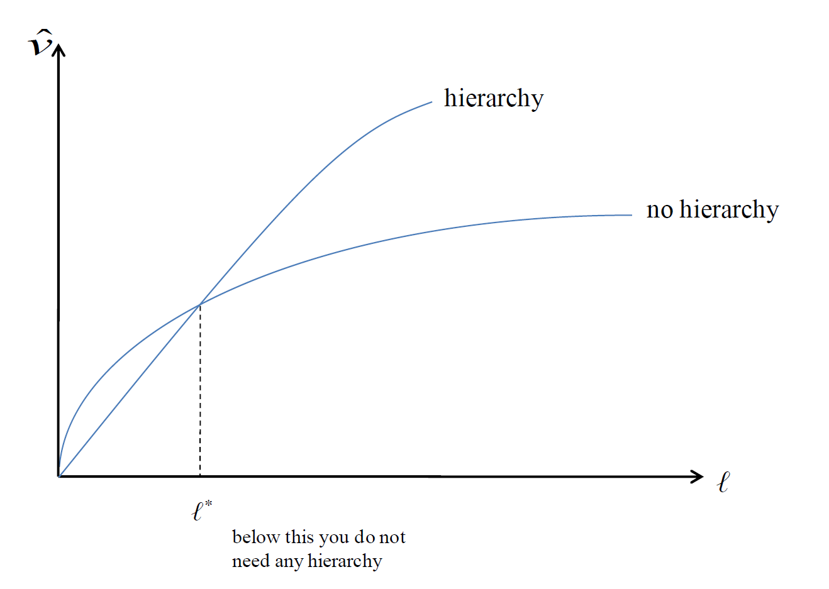
Hierarchical service (Daganzo, 2010)
Every trip involves 2 transfers
No route choice

Slide 7
Our models
A loop corridor
Assuming uniform demand, and thus evenly spaced stops
For skip-stop scheme:
Allow for more than 2 routes
B
C
Transfer
station
A
B
C
A
B
C
Transfer
station
A
B
C
A trip involving a transfer
A trip involving back-tracking
Skip-stop service

Slide 8
Our models
A loop corridor
Assuming uniform demand, and thus evenly spaced stops
For skip-stop scheme:
Allow for more than 2 routes
Allow vehicle schedule coordination at transfer stops.

Slide 9
Our models
Skip-stop scheme without service schedule coordination
Line A
Line B
Line C
Line A
x
Station C
Minimum
headway
Station B
Dwell
time
Station A
Transfer
station
t

Slide 10
Our models
Schedule coordination for skip-stop bus and BRT systems via platooning:
Lines C - B - A
x
Station C
Dwell
time
Minimum
headway
Station B
Station A
Transfer
station
t

Slide 11
Our models
A loop corridor
Assuming uniform demand, and thus evenly spaced stops
For skip-stop scheme:
Allow for more than 2 routes
Allow vehicle schedule coordination at transfer stops.
For express-local scheme:
Account for passengers’ alternative routes that involve 0 or 1 transfer.

Slide 12
Our models
Express-local scheme:
E
L
L
L
E
L
L
L
E
L
L
L
E
Express/local service

Slide 13
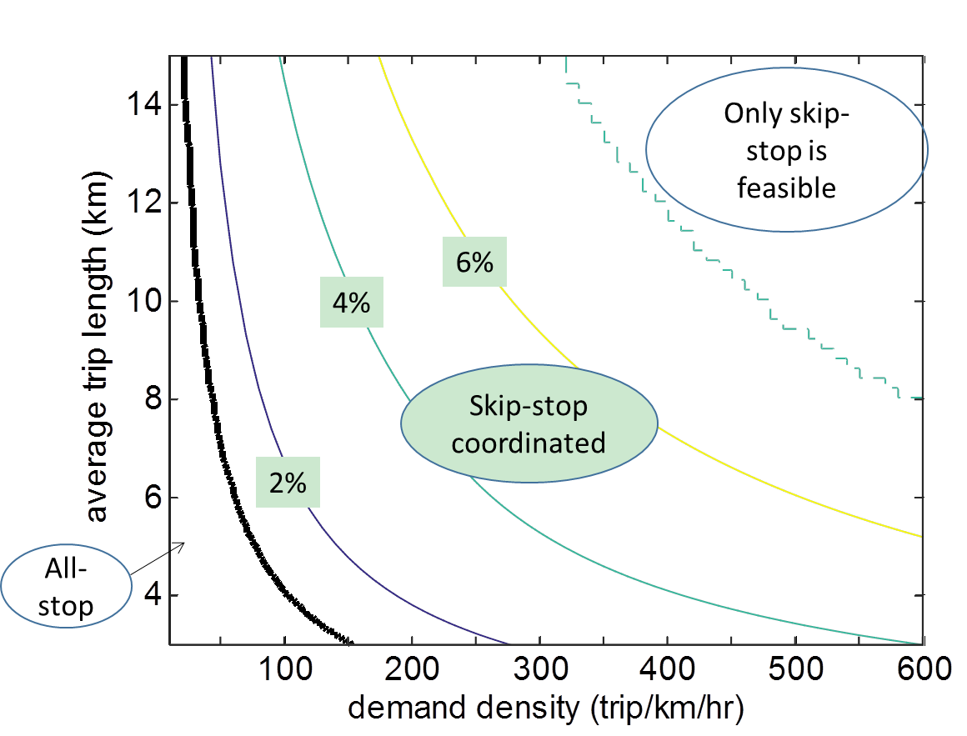
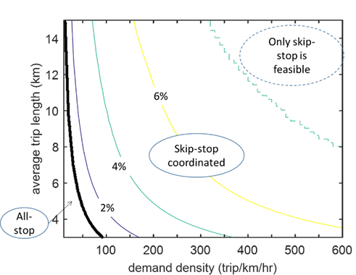
Results
Conversion of existing all-stop bus system:
Low-cost cities
(value of time = 5USD/hr)
High-cost cities
(value of time = 20USD/hr)

Slide 14
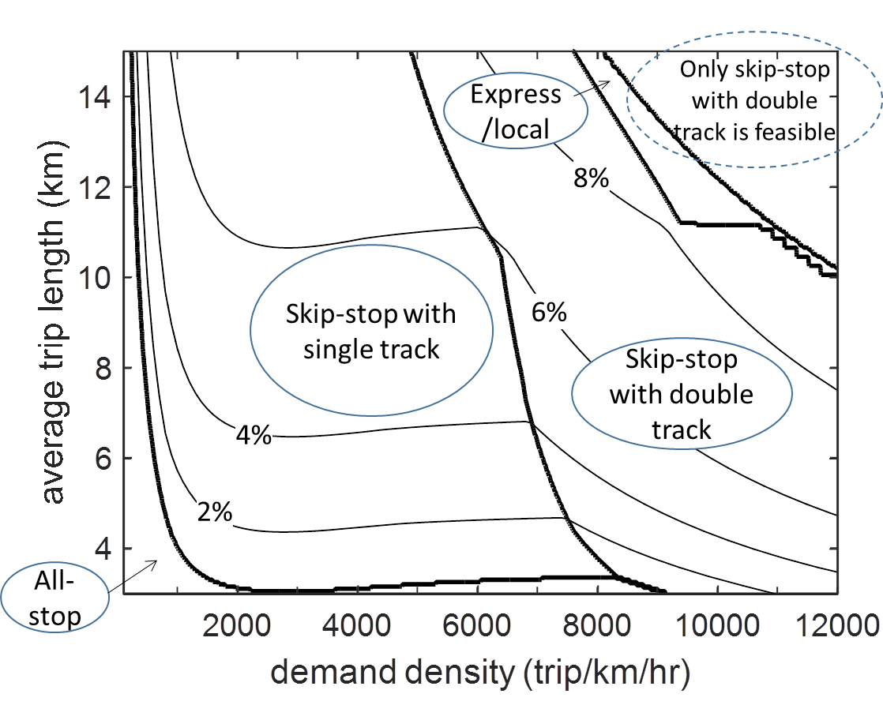
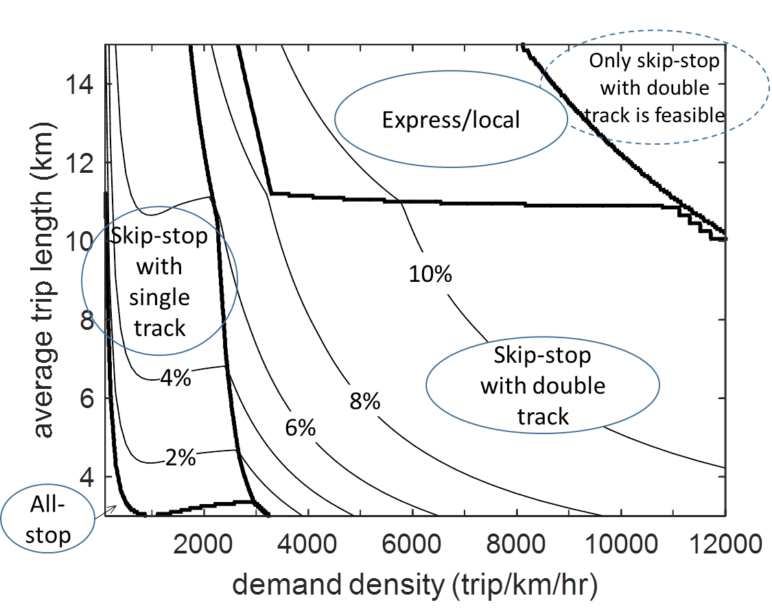
Results
Conversion of existing all-stop rail system:
Low-cost cities
(value of time = 5USD/hr)
High-cost cities
(value of time = 20USD/hr)

Slide 15
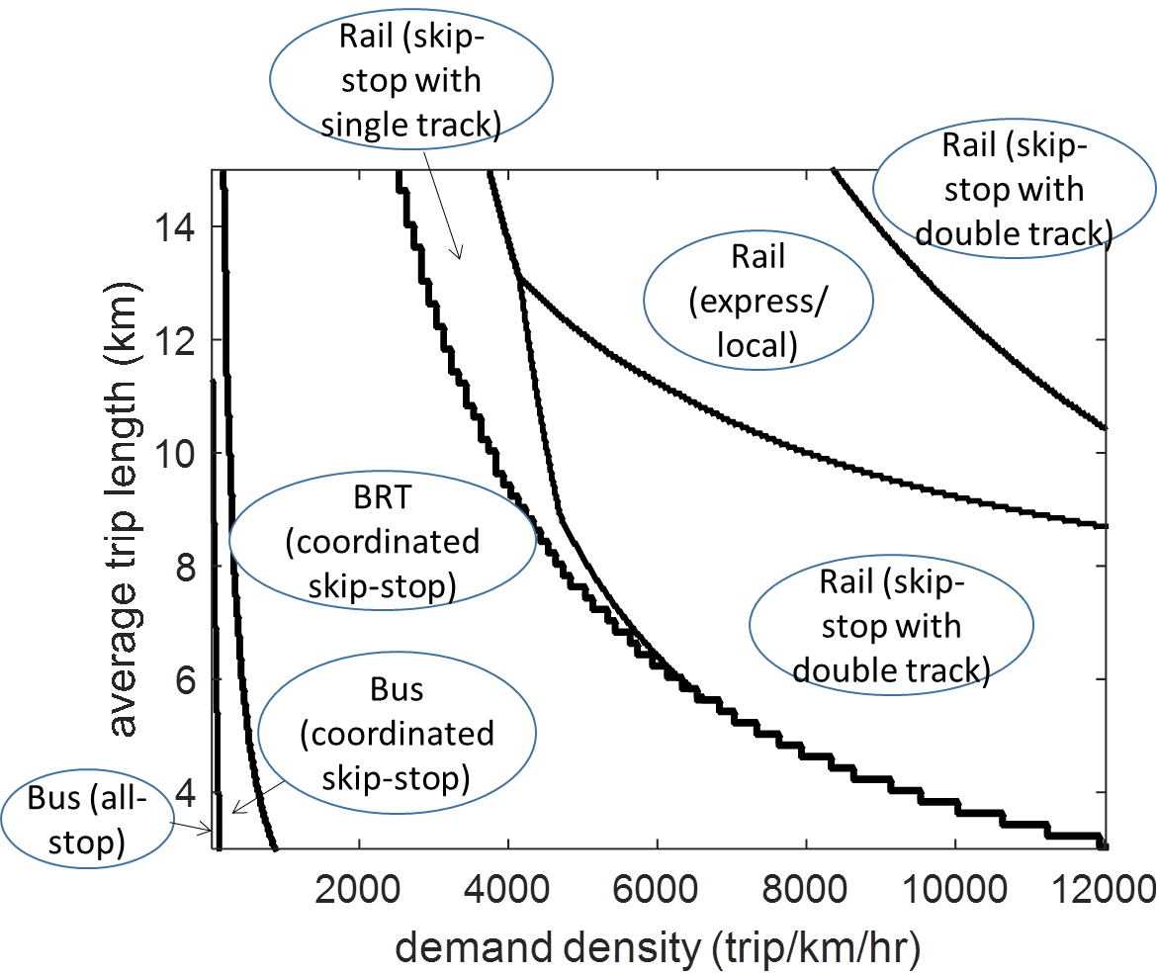
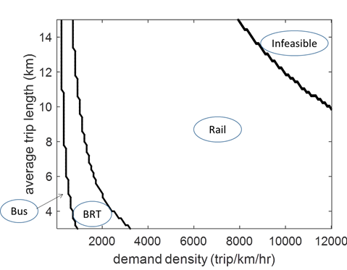
Results
Building new systems:
Low-cost cities
(value of time = 5USD/hr)
Low-cost cities: all-stop scheme only

Slide 16
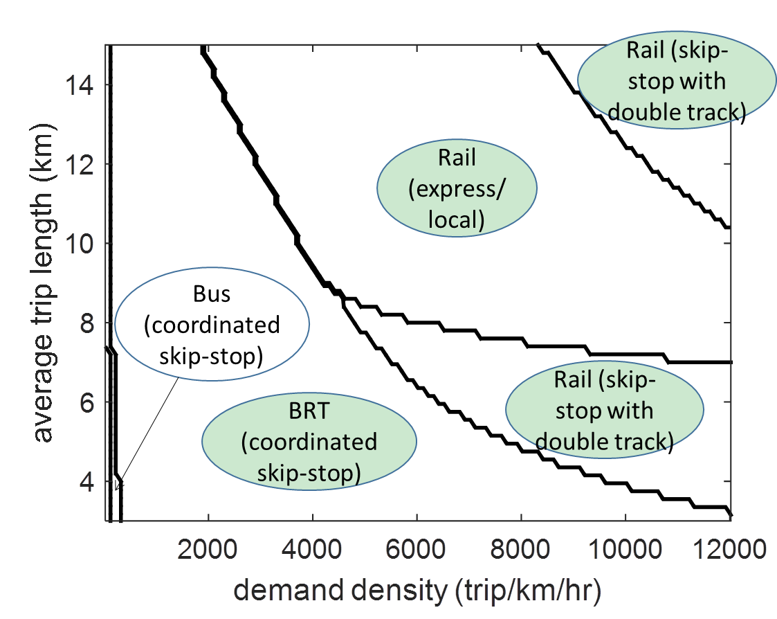
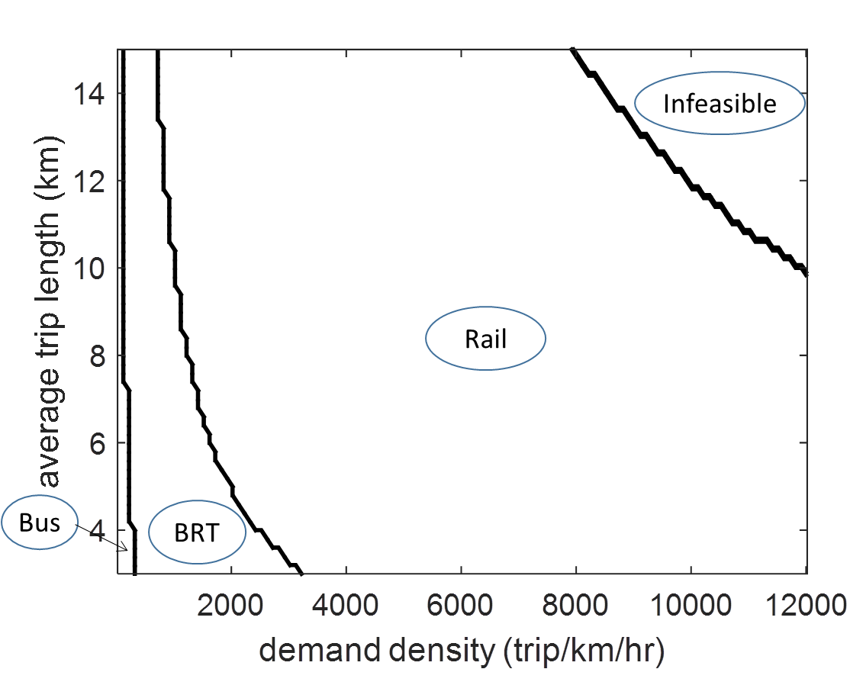
Results
Building new systems:
High-cost cities
(value of time = 20USD/hr)
High-cost cities: all-stop scheme only

Slide 17
Concluding remarks
One can benefit even in existing systems by switching to the sub-optimal alternative service strategy.
When we design from the scratch, up to 30% in cost can be saved.
Coordinated skip-stop is the clear winner for the majority of cases.
BRT under skip-stop scheme can be used to replace many new rail transit projects.

Slide 18
Questions?
Weihua Gu
weihua.gu@polyu.edu.hk

